Slide 1

AUTO MPG REGRESSION ANALYSIS Name: Osama Mufti & Gustavo Orozco STAT 311- Regression Analysis Fall 2025

Slide 2

Research Question
How do vehicle characteristics influence fuel efficiency (MPG)?
Key Questions:
Does weight affect fuel efficiency?
Did technology improve over time?
Do European and Japanese cars differ from American cars?
Has the relationship between weight and MPG changed over time?

Slide 3
Dataset Overview
Dataset: Auto MPG
Characteristic | Details
Source | UCI Machine Learning Repository/Kaggle.com
Time Period | 1970-1982
Original Size | 392 observations
After Cleaning | 392 observation (6 missing values removed)
Variables | 9 total
Key Variables:
Dependent: MPG (9.0-46.6 mpg)
Predictors: Weight, Year, Origin, Cylinders, Displacement, Horsepower, Acceleration

Slide 4
Exploratory Data Analysis
EDA: Correlation Matrix
Strong Correlations with MPG:
Multicollinearity Problem:
Cylinders→ Displacement r = 0.95
Displacement ←→ Weight r = 0,93
All engine variables are highly correlated (r>0.84)
Variable | Correlation | Strength
Weight | -0.83 | Very Strong
Displacement | -0.81 | Very Strong
Cylinder | -0.78 | Strong
Horsepower | -0.78 | Strong
Year | +0.58 | Moderate

Slide 5
EDA-MPG by Origin
MPG Varies by Manufacturing Origin
Key Finding: Japanese cars achieve 50% better fuel efficiency than American Cars!
Origin | Mean MPG | Sample Size
Japan | 30.45 | 79 Cars
Europe | 27.60 | 68 Cars
USA | 20.03 | 245 Cars

Slide 6

Model Building Strategy
Why These Models?
Model 1: Establish the baseline with the strongest predictor
Model 2 Test Main effects
Model 3: Demonstrate the multicollinearity problem
Model 4: Test if weight effect changes over time?
Four Models Tested
Model | Predictors | Purpose
Model 1 | Weight only | Baseline
Model 2 | Weight, Acceleration, Year, Origin | Initial Full model
Model 3 | All 8 predictors | Test Multicollinearity
Model 4 | Weight, Year, Origin, Weight*Year | Test Interaction

Slide 7
Winner: Model 4 Highest R² (84.3%) Lowest RMSE (3.11 MPG) All predictor Significant No Multicollinearity
Model Comparison Model Performance Comparison
Model | Rsquare | Adj Rsquare | RMSE | All sig | Issue
Model 1 | 69.2% | 69.1% | 4.33 | Sig | Limited
Model 2 | 81.9% | 81.7% | 3.34 | No Sig | Acceleration NS
Model 3 | 82.4% | 82.1% | 3.31 | No Sig | Multicollinearity
Model 4 | 84.3% | 84..1% | 3.11 | Sig | None

Slide 8
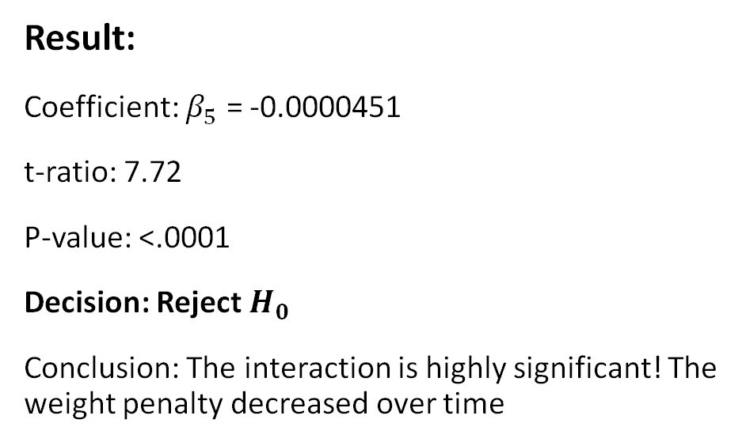
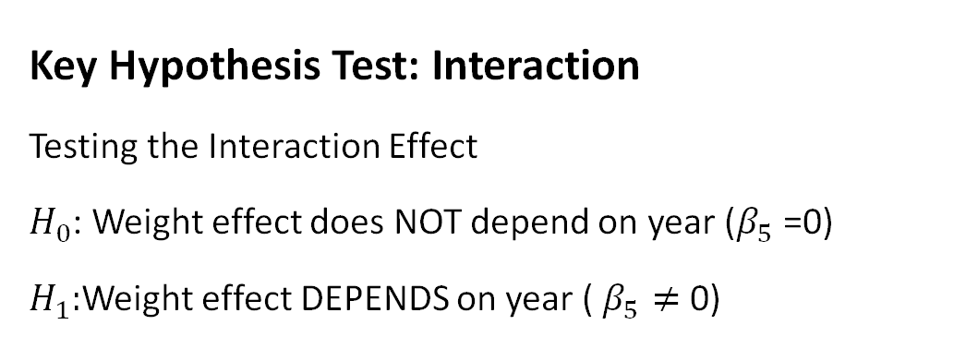
Model 4- Hypothesis Tests
Key Hypothesis Test: Interaction
Testing the Interaction Effect
$H_{0}$: Weight effect does NOT depend on year ($β_{5}$ =0)
$H_{1}:$Weight effect DEPENDS on year ( $β_{5}≠$ 0)
Result:
Coefficient: $β_{5}$ = -0.0000451
t-ratio: 7.72
P-value: <.0001
Decision: Reject $H_{0}$
Conclusion: The interaction is highly significant! The weight penalty decreased over time

Slide 9
All Predictors Significant:
Predictor | P-value | Significant?
Weight | <0.0001 | Significant
Year | <.0001 | Significant
Origin_Europe | <.0001 | Significant
Origin_Japan | 0.0006 | Significant
Weight * Year | <0.0001 | Significant

Slide 10
Speaking engagement metrics
Impact factor | Measurement | Target | Achieved
Audience interaction | Percentage (%) | 85 | 88
Knowledge retention | Percentage (%) | 75 | 80
Post-presentation surveys | Average rating | 4.2 | 4.5
Referral rate | Percentage (%) | 10 | 12
Collaboration opportunities | # of opportunities | 8 | 10

Slide 11
Model 4 – The Interaction Effect
Year | Weight Effect (per 1,000 Ibs) | Change
1970 | -7.36 mpg | Baseline (Heavy penalty
1976 | -7.09 mpg | Improved by 0.27 mpg
1982 | -6.81 mpg | Improved by 0.55 mpg
What Does the Interaction Mean?
Weight Effect Changes Over Time:
Total Improvement: 7.5% reduction in weight penalty
Why Did This Happen?
1973 Oil Crisis: Urgent need for efficiency 1975 CAFÉ Standard Regulatory Pressure Technology: Electronic fuel Injection, better aerodynamics, Lighter material terial Heavy cars benefited MORE from these improved aerodynamics

Slide 12

Predictor | Coefficient | P-value | Interpretation
Weight | +0.885 | <.0001 | Modified by interaction
Year | +2.041 | <.0001 | -0.76 mpg improvement per year
Origin_Europe | +2.145 | <.0001 | +2.15 mpg vs USA
Origin_Japan | +1.682 | 0.0006 | +1.68 mpg vs USA
Weight * Year | -0.000451 | <.0001 | Reduces weight penalty over time
Model 4 Results- Coefficients
Model Performance:
Rsquare = 84.3%
RMSE = 3.11 mpg
RMSE = 3.11 mpg

Slide 13
Key Findings Summary
Weight is the Dominant Factor Strongest predictor ( r =-0.83) Effect: -6.8 to –7.4 mpg per 1,000 Lbs
2. Significant Interaction Discovered Weight penalty decreased 7.5% from 1970 to 1982 Technology reduced the cost of weight
3. Technology Improved Efficiency Average improvement: 0.76 mpg per year Total 1970-1982: 9-mpg improvement
4. Origin Matters Japan: +1.68 mpg vs USA Europe:+2.15 mpg vs USA
5. Model 4 is Best Rsquare = 84.3% all predictors significant

Slide 14

Conclusions
Model 4 successfully answers the research question
Main Conclusions:
1.Weight dominates fuel efficiency (Strongest effect)
2. Interaction is real-technology reduced weight penalty over time
3.Origin matters-Japanese/European cars more efficient
4.Model 4 is best-84.3% Rsquare, all significant, no violation

